Slide 1




Talent Factory
Final MERN Project
2023
13/12/2023
arkx.group

Slide 2




Talent Factory
GROUP members
KOTBI Mohammed
CHARRAH Hajar
RERHAYE
Mohammed
arkx.group
1
Notes:
1.7.2013
‹#›

Slide 3
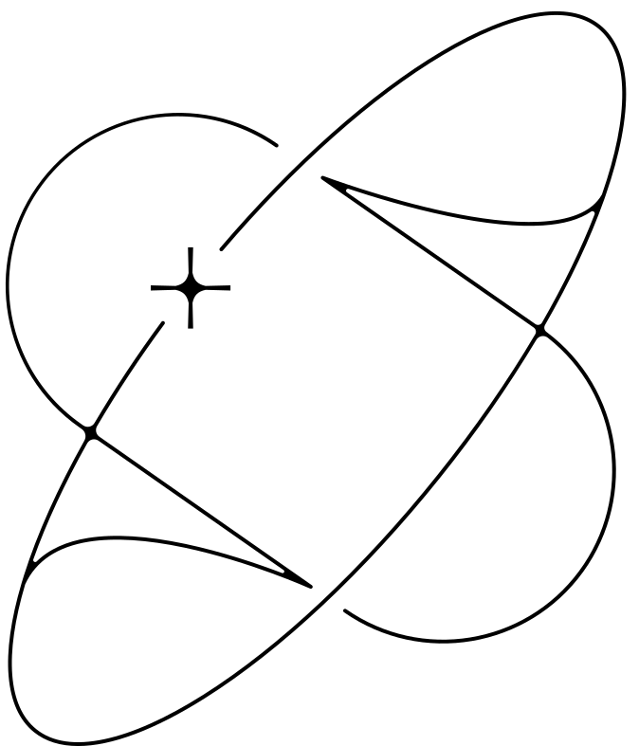

Talent Factory
Problem Overview
25
Organic products are gradually gaining a foothold in Moroccan supermarkets, but their availability is limited due to a scarcity of locally certified supplies. The demand for pesticide-free foods, produced in an environmentally friendly manner, is on the rise in Morocco, reflecting a growing preference for healthy eating. However, the country faces challenges in distribution and logistics, given the scarcity of specialized points of sale for organic products. The shift towards a healthier lifestyle has become more evident, particularly in the aftermath of the COVID-19 pandemic, prompting people to prioritize nutritious choices in their diets.

Slide 4

PROPOSED SOLUTION AND THOUGHT PROCESS
Talent Factory
1-Understanding consumer needs
2-Proposal of a diversified product offering
3-Effective communication
the thought process for our project:
Define the Objectives : Identify the target audience and understand their needs and preferences.
Market Research : products, eco-friendly packaging and sustainable practices.
User Experience (UX) Design : User-friendly interface with emphasis on easy navigation and a smooth shopping experience.
Content Strategy : Include product descriptions, user reviews, and educational content about organic living.
E-commerce features : Include features like a shopping cart, secure payment gateways, and order tracking.
Visual Design : Choose a clean, visually appealing design that aligns with the organic and eco-friendly theme.
arkx.group
2
Notes:
1.7.2013
‹#›

Slide 5

Talent Factory
Project Title and Theme
25
Project Title :
GreenVille: Online store of organic and natural products
A Marketplace that provides a large range of organic and natural products
online in Morocco.
Theme :
On our online platform you will find a wide selection of products from the biggest local and foreign brands at the best value for money meeting all quality standards.
Your online purchases at your fingertips in just a few clicks and the best local products, superfoods and cosmetics....
Fast delivery everywhere in Morocco

Slide 6

User Interaction (User Flow)
Talent Factory
Home Page
User Account
Product Exploration
Contact and support
Product details
Educational content
Promotions
Continuous improvements
Shopping cart
Chekout
arkx.group
3
Notes:
1.7.2013
‹#›

Slide 7
Project parts
Frontoffice
Backend
Backoffice
Project Parts
Talent Factory
25

Slide 8
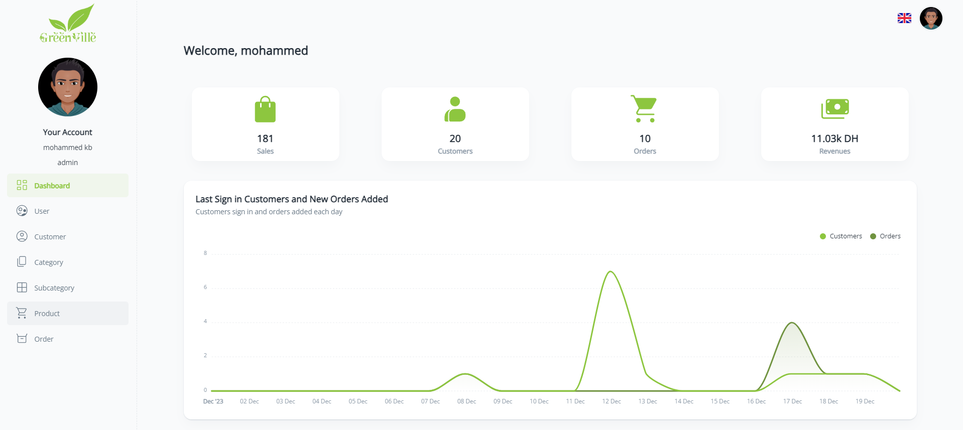
Screenshots of Interfaces
Talent Factory
25

Slide 9

Screenshots of Interfaces
Talent Factory
25

Slide 10
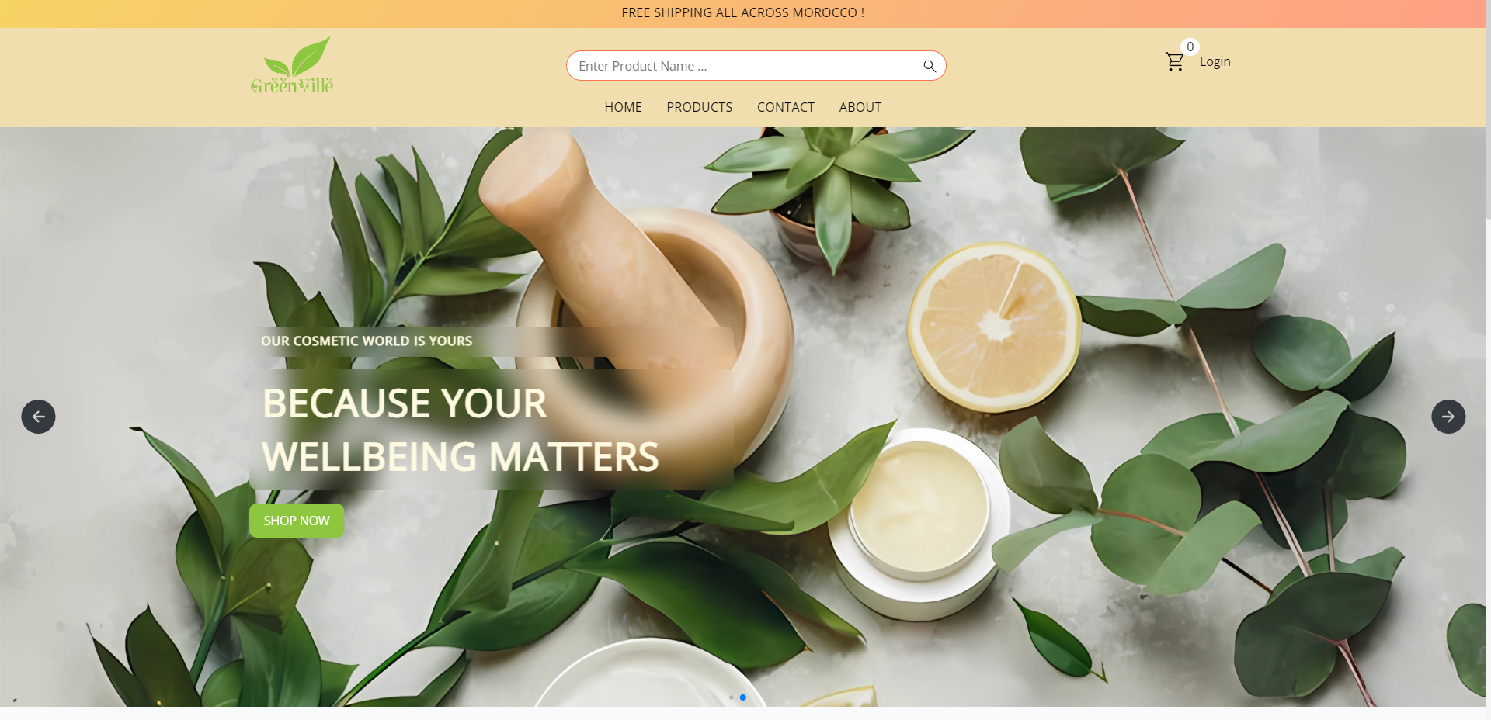
Screenshots of Interfaces
Talent Factory
25

Slide 11
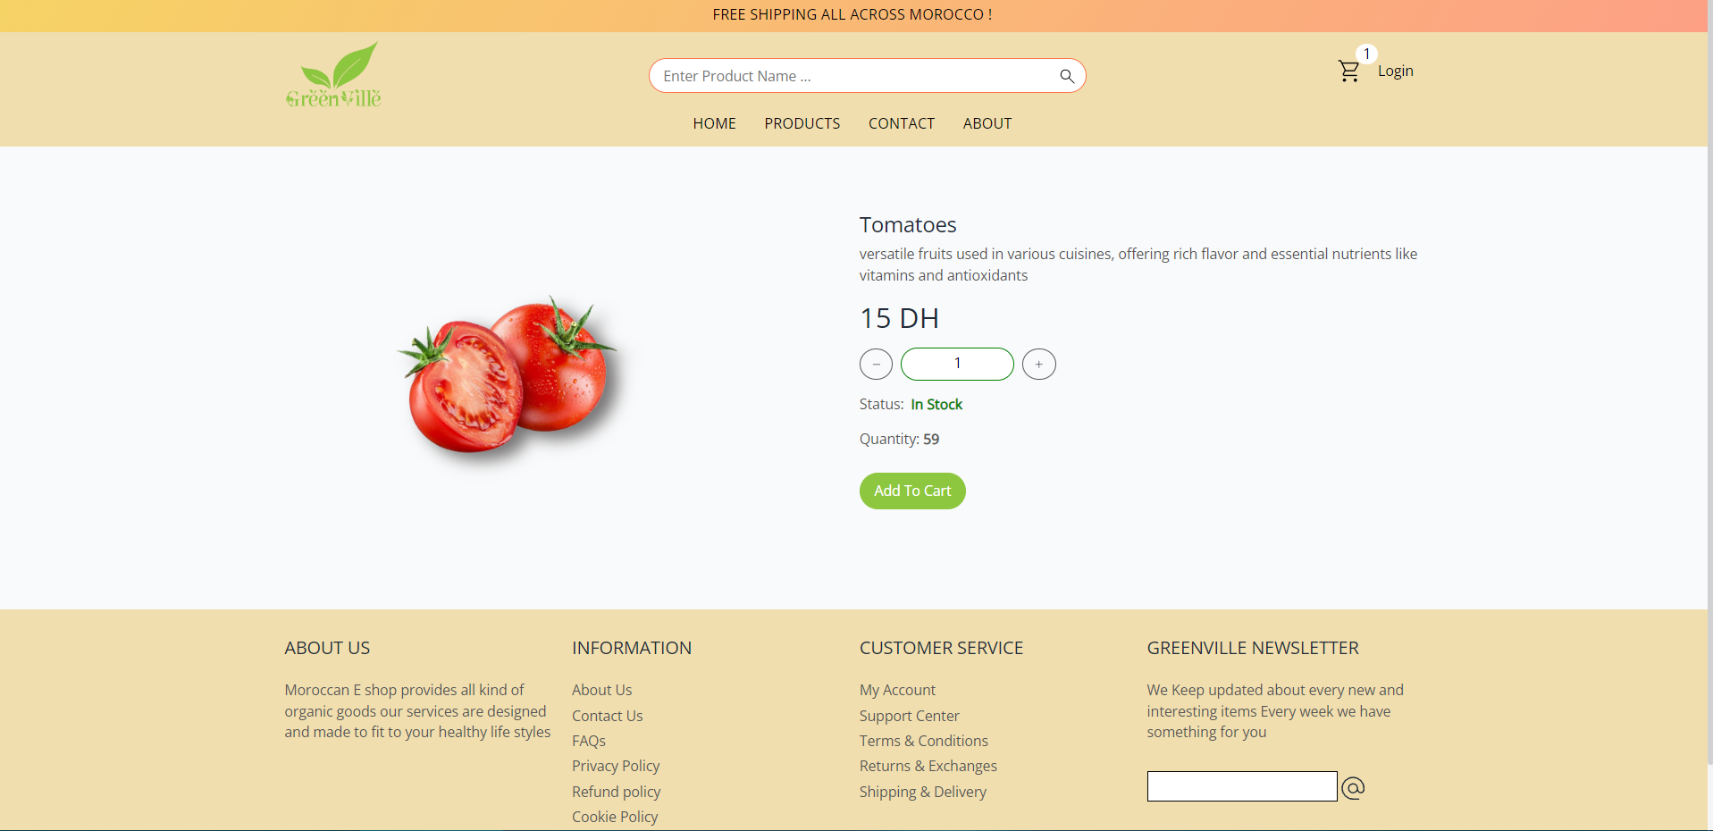
Screenshots of Interfaces
Talent Factory
25

Slide 12
Technologies used
Talent Factory
Express
Mongoose
Multer
MongoDB
JWT
React
MUI
Vite
Redux
5
Notes:
1.7.2013
‹#›

Slide 13
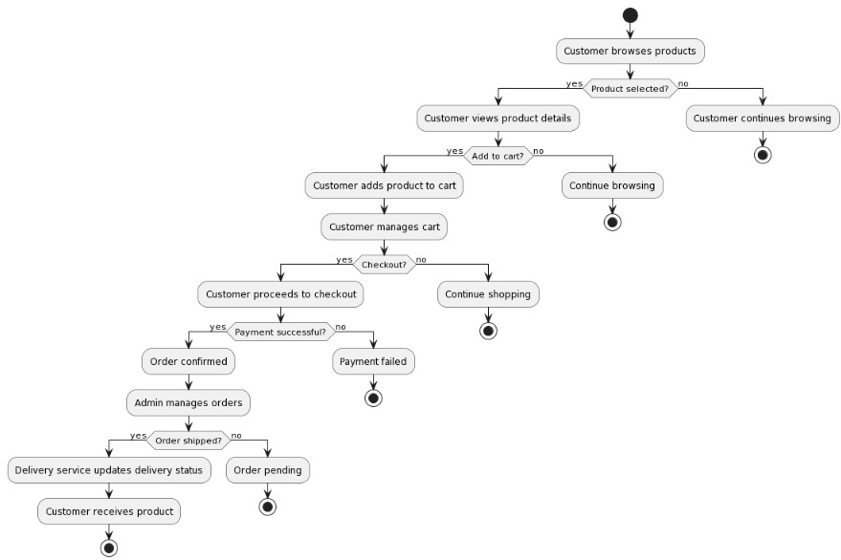
Talent Factory
Architecture of Backend and frontend
25

Slide 14
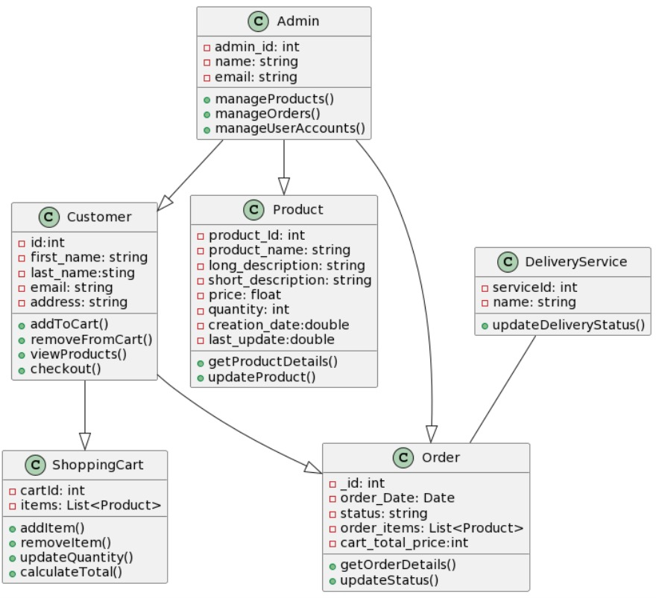

Architecture of Backend and frontend
Talent Factory
arkx.group
4
Notes:
1.7.2013
‹#›

Slide 15
Talent Factory
25
LIVE DEMO

Slide 16
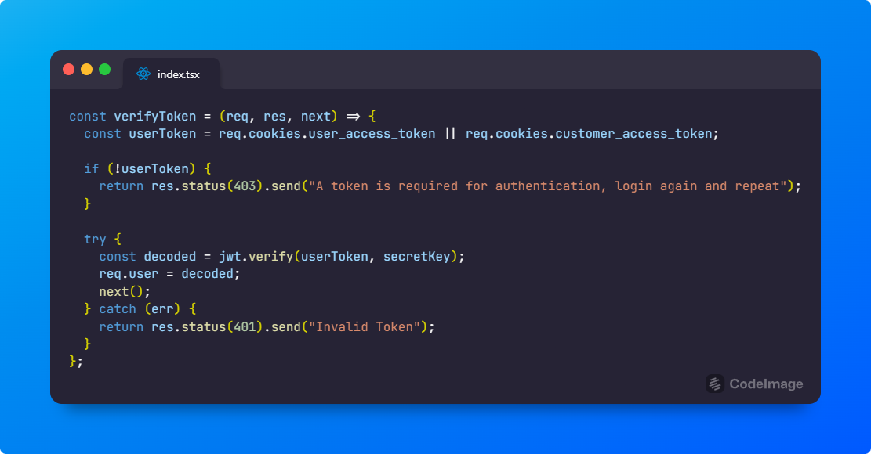
Talent Factory
SNIPPETS
25

Slide 17
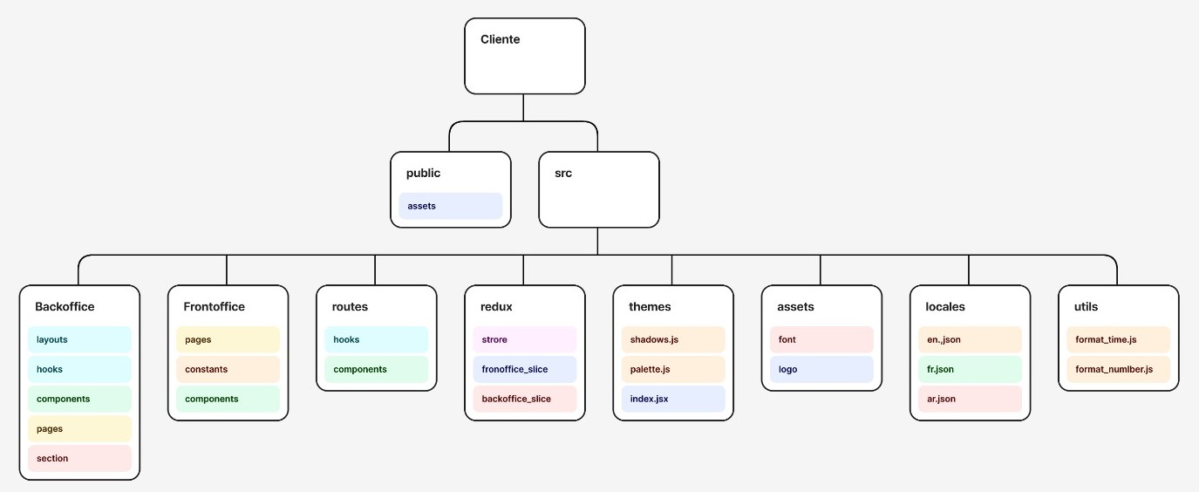
Talent Factory
Code Structure and Snippets
25

Slide 18
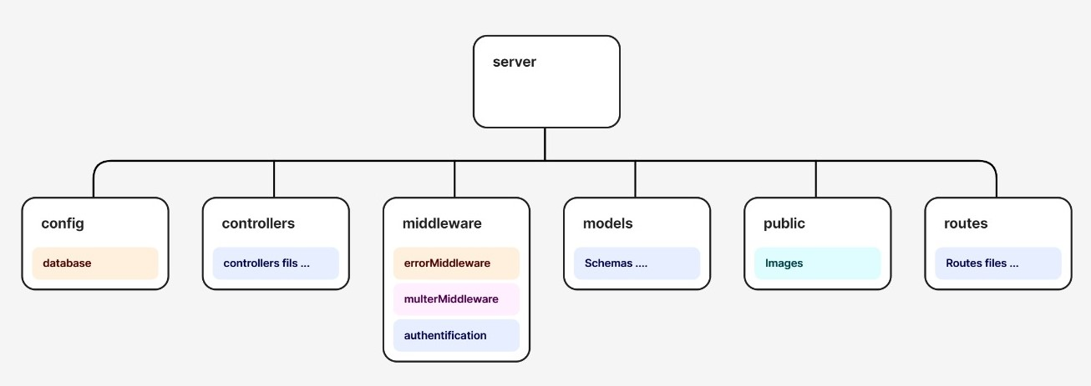
Talent Factory
Code Structure and Snippets
25

Slide 19
Talent Factory
After action review
25
Obstacles we overcome
What went well
What did we learn
If we had to do it again, what would we change

Slide 20

Talent Factory
THANK YOU FOR YOUR ATTENTION
arkx.group
8
Notes:
1.7.2013
‹#›

